Slide 1
Exploring Routing Asymmetry in FABRIC
Krishnaprasad Aji

Slide 2
Asymmetric Routing
Packets take one path to the destination and take a different path while returning to the source
Common within most networks
Larger the network, more likely there is asymmetric routing

Slide 3
Objective
Identify routing asymmetry within FABRIC
Quantify the asymmetry of such paths

Slide 4
Background and Motivation
He, Yihua & Faloutsos, Michalis & Krishnamurthy, S. & Huffaker, B.. (2005). On routing asymmetry in the Internet
de Vries, W., Santanna, J.J., Sperotto, A., Pras, A. (2015). How Asymmetric Is the Internet?
Katz-Bassett, E., Madhyastha, H., Adhikari, V.: Reverse traceroute. In: Network Systems Design and Implementation (2010)
Yihua He, M. Faloutsos and S. Krishnamurthy, "Quantifying routing asymmetry in the Internet at the AS level" (2004)
Luckie, M., Hyun, Y., & Huffaker, B. (2008). Traceroute probe method and forward IP path inference.

Slide 5
Methodology
Identify one-way latencies between pairs of nodes
Significant difference in forward and reverse latencies is an indicator of asymmetric routing paths
Traceroute probing to identify the paths and establish asymmetry
Quantifying the asymmetrical paths to identify extent of asymmetry

Slide 6
One-Way Latency Measurement with PTP
10 PTP compatible sites in FABRIC :
STAR, MAX, MICH, MASS, UTAH, NCSA, UCSD, FIU, CLEM, and CERN
GPS- disciplined clocks at each of the sites
UDP packets sent from source to destination
Timestamp of the the packets is used to measure the latency
Provides accurate one-way latency measurements

Slide 7
Traceroute
Maps the route that packets take from a source to a destination
Sends packets with gradually increasing TTL values
Routers along the path respond with ICMP time exceeded messages
Records the responses and builds a list of hops traversed

Slide 8
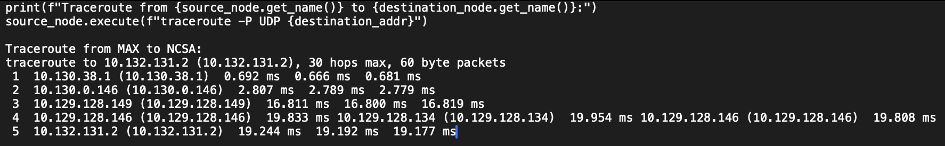
Traceroute Analysis

Slide 9
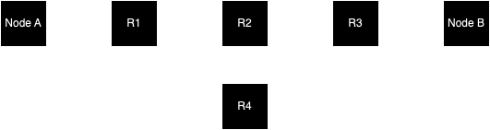
Identifying Genuine Asymmetry
Symmetry:
R1 -> R2 -> R3 path : (b,d,f,h)
R3 -> R2 -> R1 path : (g,e,c,a)
Asymmetry:
R1 -> R2 -> R3 path : (b,d,f,h)
R3 -> R4 -> R1 path : (g,j,l,a)

Slide 10
Quantifying Routing Asymmetry
Find the dissimilarity of entities in the two paths considered in a sequence
Dissimilarity between two paths can be measured as the minimal total cost incurred in aligning them
Similar to comparing sequences of genes in computational biology where string matching techniques are used

Slide 11
Quantifying Routing Asymmetry Contd.
u = (u₁, u₂, u₃, … , u_{m}) - forward path
v = (v_{n}, v_{n-1}, v_{n-2}, … , v₁) - reverse path
Ω(S) = { ω[x, y]} , x∈ S , y∈ S : non-negative base dissimilarity value
Ψ sequentially maps all indices in path u to the set of indices of a subset of v
Ψ’ sequentially maps all indices in path v to the set of indices of a subset of u
Minimal Composite Dissimilarity = min { C(u,v, Ω, Ψ, Ψ’) }∀ Ψ, Ψ’

Slide 12
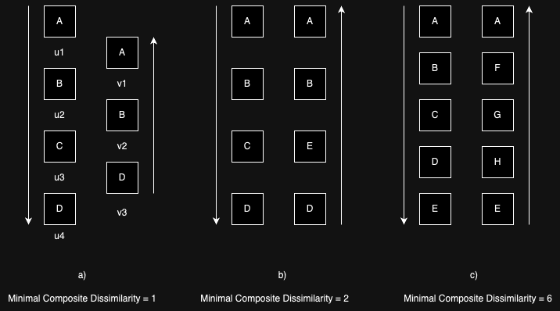
Quantifying Routing Asymmetry Contd.

Slide 13
Absolute and Normalized Asymmetry
Absolute Asymmetry = Minimal Composite Dissimilarity
Normalized Asymmetry = Absolute Asymmetry / total length of both paths

Slide 14
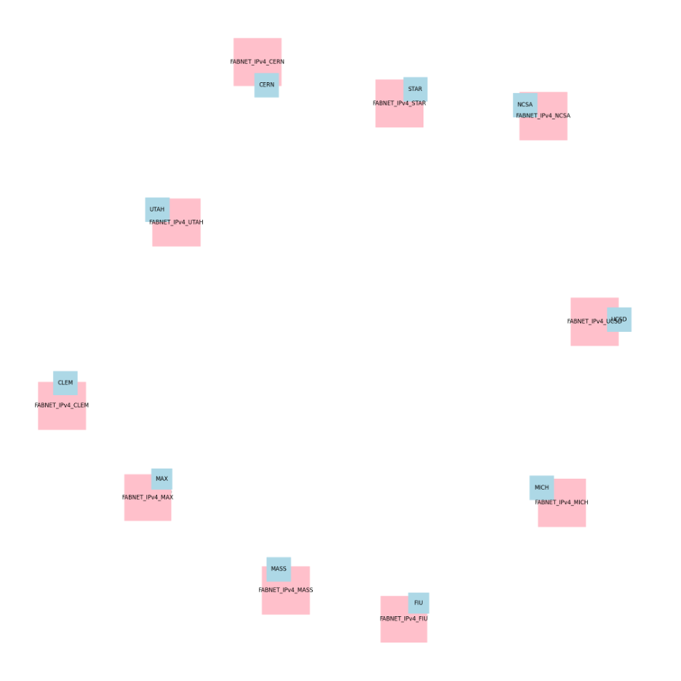
Topology
Nodes in 10 PTP Compatible sites
Basic NICs
FABNETv4 internet

Slide 15
Experiment
Find OWL between pairs of nodes
Identify pairs of nodes with significant difference in OWL
Traceroute probing to identify the forward and reverse paths
Identifying asymmetric paths
Quantifying the asymmetry of paths

Slide 16
Results
Source | Destination | OWL(ms) | difference
CLEM | CERN | 63.29 | 9.86
CERN | CLEM | 53.43
STAR | CERN | 51.85 | 8.44
CERN | STAR | 60.29
CERN | MASS | 50.98 | 5.28
MASS | CERN | 56.26
CERN | UTAH | 67.86 | 4.91
UTAH | CERN | 72.77

Slide 17
Results
Node pairs | A A | N A | len(u)+len(v)
CERN, UTAH | 2 | 0.2 | 10
CERN, MASS | 2 | 0.33 | 6
CERN, STAR | 2 | 0.33 | 6
UCSD, MASS | 4 | 0.33 | 12
UCSD, FIU | 8 | 0.66 | 12
UCSD, CLEM | 4 | 0.33 | 12

Slide 18
Conclusion
13.33 % of the paths taken for the experiment are asymmetrical
CERN and UCSD are nodes which have the most asymmetric paths

Slide 19
References
I. Baldin et al., "FABRIC: A National-Scale Programmable Experimental Network Infrastructure," in IEEE Internet Computing, vol. 23, no. 6, pp. 38-47, 1 Nov.-Dec. 2019, doi: 10.1109/MIC.2019.2958545.
He, Yihua & Faloutsos, Michalis & Krishnamurthy, S. & Huffaker, B.. (2005). On routing asymmetry in the Internet. 2. 6 pp.. 10.1109/GLOCOM.2005.1577769..
Luckie, M., Hyun, Y., & Huffaker, B. (2008). Traceroute probe method and forward IP path inference. In Proceedings of the 8th ACM SIGCOMM conference on Internet measurement (pp. 311-324)K. Elissa, “Title of paper if known,” unpublished.
Fabric Testbed. KNIT6_MFLIB_TUTORIAL (2023), [Jupyter notebook]. Retrieved from https://portal.fabric-testbed.net/
Sharan, V. (2023). Round-Trip Time Measurement in FABRIC. Unpublished project paper for Advanced Computer Networks, Arizona State University.
Yihua He, M. Faloutsos and S. Krishnamurthy, "Quantifying routing asymmetry in the Internet at the AS level," IEEE Global Telecommunications Conference, 2004. GLOBECOM '04., Dallas, TX, USA, 2004, pp. 1474-1479 Vol.3, doi: 10.1109/GLOCOM.2004.1378227.
de Vries, W., Santanna, J.J., Sperotto, A., Pras, A. (2015). How Asymmetric Is the Internet?. In: Latré, S., Charalambides, M., François, J., Schmitt, C., Stiller, B. (eds) Intelligent Mechanisms for Network Configuration and Security. AIMS 2015. Lecture Notes in Computer Science(), vol 9122. Springer, Cham.
Katz-Bassett, E., Madhyastha, H., Adhikari, V.: Reverse traceroute. In: NetworkSystems Design and Implementation (2010), https://www.usenix.org/legacy/event/nsdi10/tech/full_papers/katz-bassett.pdf

Slide 20
Questions ?

